Slide 1
Poetry
Genius Hour Project By: Taylor Wickman

Slide 2
Why Poetry?
The inevitability of daydreaming brings on ideas and questions that many of us don’t even realize during the course of the day. What if there was a way you could write down your dreams and emotions to express yourself in a creative way? BAM! Poetry.

Slide 3
What is Poetry?
Poetry is a genre of Literature that is characterized by the unique rhythm and patterns of writings expressed by the writer.

Slide 4
Types of Poetry
There are many different types of poetry. Here are just a couple examples...
Acrostic
Concrete
Haiku
Couplets
Blank Verse
Visual
Lyric

Slide 5
Acrostic
Tall
Amazing (Duh)
Young
Loud
Outgoing
Realistic
This form of poetry, has the first letters of each line aligned vertically to form a word. The word often is the subject of the poem.

Slide 6
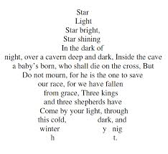
Concrete
Concrete poems are in the shape of the subject they relate to.
(A poem in the shape of a tree describing nature)

Slide 7
Haiku
Summer
When going Outside (5)
People will need protection (7)
From the hot sun’s rays (5)
Taylor Wickman
A Haiku is a very old form of Japanese Poetry. It consists of 17 syllables.
5-7-5

Slide 8
Couplets
The couplet is the easiest of the poetry forms. It consists of two lines with an end rhyme.
I seem to be losing my hair
There isn't any left there.
Taylor Wickman

Slide 9
Blank Verse
There is no rhyme scheme in a Blank Verse poem, but it usually is very impactful on the reader.
The Ball Poem
by
John Berryman
What is the boy now, who has lost his ball,
What, what is he to do? I saw it go
Merrily bouncing, down the street, and then
Merrily over-there it is in the water!

Slide 10
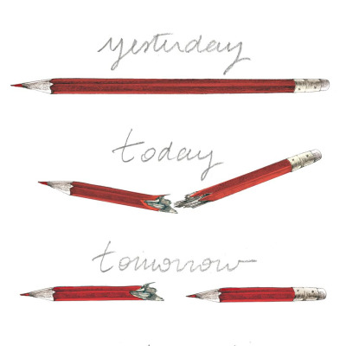
Visual
Visual Poems use arrangement of text, images, and symbols to help show the meaning of the poem.

Slide 11
Lyric
Rearrange song lyrics to change the meaning to fit your thoughts.
Her
Can’t go on without her.
It’s all wrong without her.
There’s no song without her.
Harry Nilsson

Slide 12
Elements of Poetry!
Stanzas
Rhyme
Rhyme Scheme
Meter
Simile
Personification
Irony
Symbol
Metaphor

Slide 13
Stanzas
Stanzas are a series of lines grouped together and separated by an empty line from other stanzas. They are the similar a paragraph in an essay. One way to identify a stanza is to count the number of lines.
couplet (2 lines)
tercet (3 lines)
quatrain (4 lines)
cinquain (5 lines)
sestet (6 lines)
septet (7 lines)
octave (8 lines)

Slide 14
Rhyme and Rhyme Scheme
Rhyme is the repetition of similar sounds.
Rhyme Scheme is the pattern of the Rhymes.
I saw a fairy in the wood,
He was dressed all in green.
He drew his sword while I just stood,
And realized I'd been seen.
The rhyme scheme of the poem is abab.

Slide 15
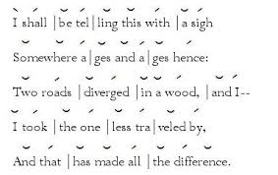
Meter
Meter is the basic rhythmic structure of a verse or lines in verse.

Slide 16
Simile
Metaphor
Comparing two things using like or as.
“She is like a rose.”
Comparing two things not using like or as.
“The moon is a new sun.”

Slide 17
Personification
Giving something non-human human characteristics.
SUN
The sun waved its shining rays at me, greeting me with it’s morning warmth.
Taylor Wickman

Slide 18
Irony
Saying something that means something else, usually accompanied with humor.
(Confusing but easy with an example)
A fire station burns down
The marriage counselor files for divorce
The police station gets robbed
A pilot had a fear of heights
A member of PETA wears leather shoes
The teacher failed the test

Slide 19
Symbols
Is the use of an object or a word to represent an an action, person, place, word, or object.

Slide 20
Poetry
I hope my examples and structure of poems will help you in your future endeavours of writing!
Thank You
Taylor Wickman Class of 2015

Slide 21
Helpful Links (My Sources)
Poetry Lovers’ Page
Everypoet
Bartleby
Norton Poets Online
Poem Hunter
Exploring Poetry
Old Poetry
Famous Poets and Poems
Net Poets
The Poetry Archive

